Slide 1

Sentiment Analysis for Restaurant Reviews
By:
Sana Parveen
M.tech Data Science

Slide 2
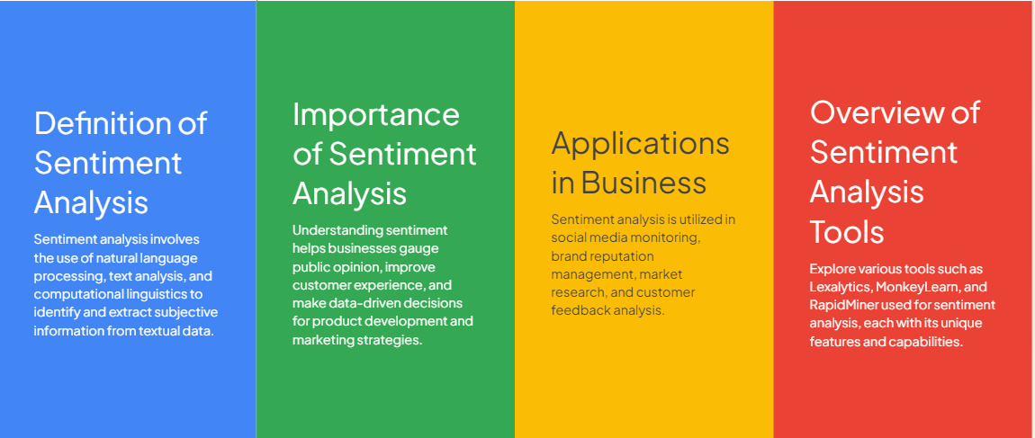
Introduction to Sentiment Analysis

Slide 3
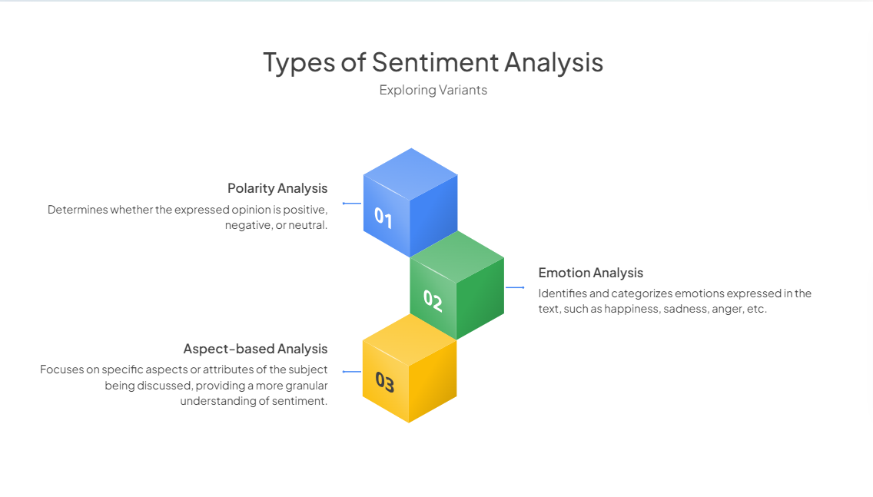

Slide 4
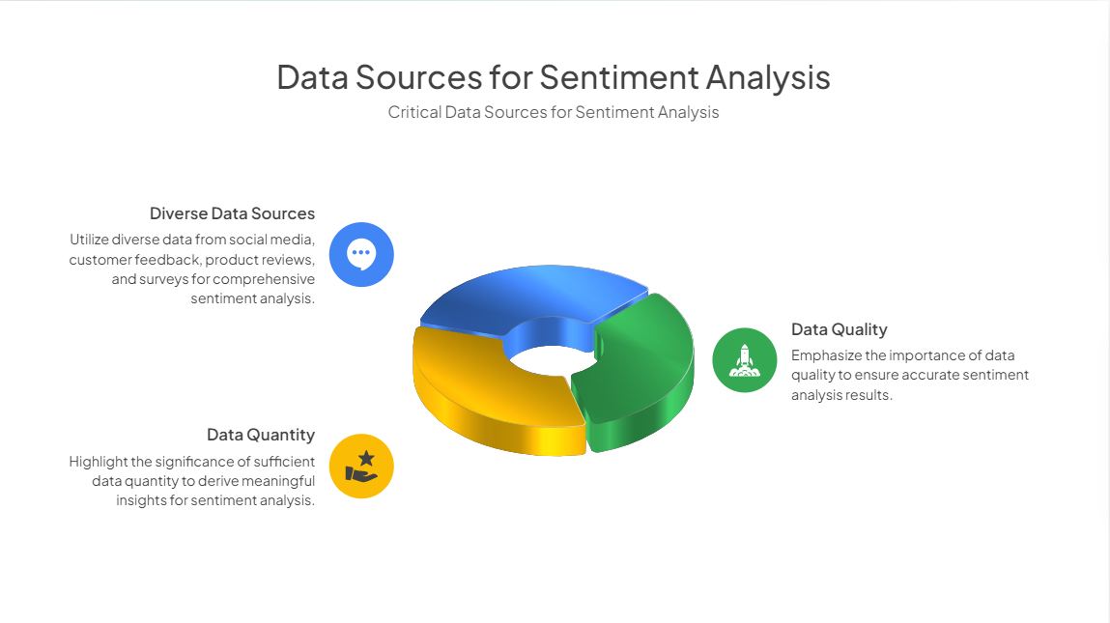

Slide 5


Slide 6
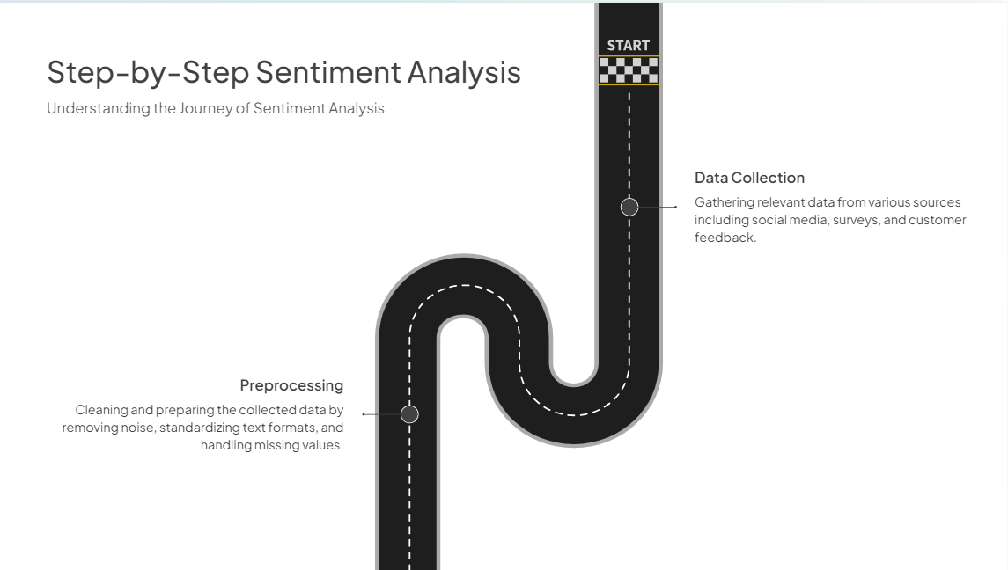

Slide 7
Case Study :Zomato Restaurant Reviews

Slide 8
Sentiment Lexicon -
CODE
# Load the packages into R session
library(tidyverse)
library(tidytext)
library(ggplot2)
my_data <- read.delim("path/to/your/reviews.tsv", header = TRUE, sep = "\t")
# Tokenize the reviews into words
words <- my_data %>%
unnest_tokens(word, Review)
# Join with Bing lexicon
sentiment_analysis <- words %>%
inner_join(get_sentiments("bing")) %>%
count(Restaurant, sentiment) %>%
spread(sentiment, n, fill = 0)
# Calculate a simple sentiment score (optional)
sentiment_analysis <- sentiment_analysis %>%
mutate(sentiment_score = positive - negative)
#Bar plot showing the number of positive and negative comments per restaurant.
ggplot(sentiment_analysis, aes(x = Restaurant, y = positive, fill = "Positive")) +
geom_bar(stat = "identity", position = "dodge") +
geom_bar(aes(y = -negative, fill = "Negative"), stat = "identity", position = "dodge") +
scale_y_continuous(labels = abs) +
labs(title = "Positive vs Negative Comments by Restaurant",
x = "Restaurant",
y = "Number of Comments",
fill = "Sentiment") +
theme_minimal() +
theme(axis.text.x = element_text(angle = 45, hjust = 1))

Slide 9
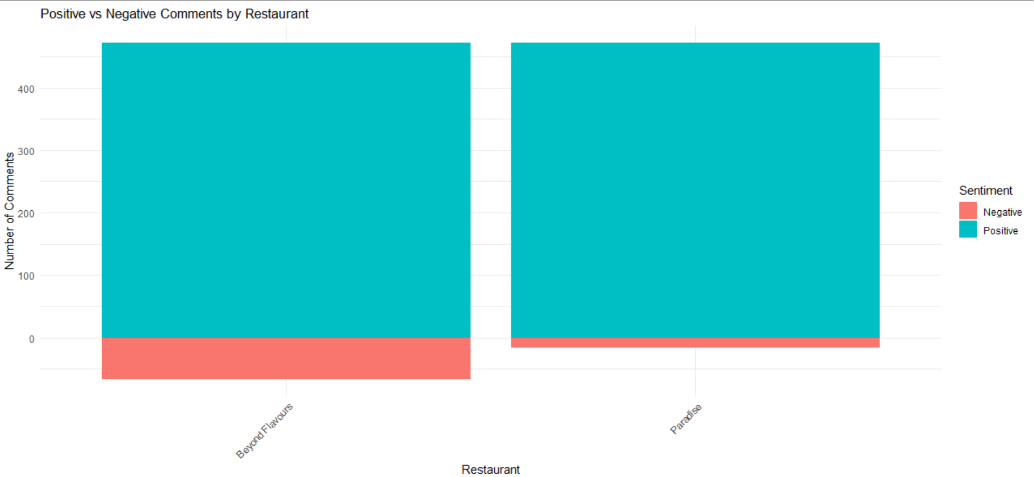

Slide 10
Keyword Frequency Analysis
Code
library(tidytext)
library(dplyr)
# Assuming 'Review' is the column in 'my_data' that contains the text of the reviews
reviews_tokens <- my_data %>%
unnest_tokens(word, Review)
# Define a vector of positive keywords (add more as you see fit)
positive_keywords <- c("excellent", "great", "love", "best", "amazing", "delicious")
# Define a vector of negative keywords
negative_keywords <- c("disappointed", "poor", "worst", "bad", "terrible", "awful")
# Count the frequency of positive keywords
positive_counts <- reviews_tokens %>%
filter(word %in% positive_keywords) %>%
count(word) %>%
mutate(sentiment = "positive")
# Count the frequency of negative keywords
negative_counts <- reviews_tokens %>%
filter(word %in% negative_keywords) %>%
count(word) %>%
mutate(sentiment = "negative")
# Combine the counts and plot
keyword_counts <- bind_rows(positive_counts, negative_counts)
ggplot(keyword_counts, aes(x = reorder(word, n), y = n, fill = sentiment)) +
geom_col() +
coord_flip() +
labs(x = "Keyword", y = "Frequency", title = "Frequency of Positive and Negative Keywords in Reviews") +
theme_minimal()

Slide 11
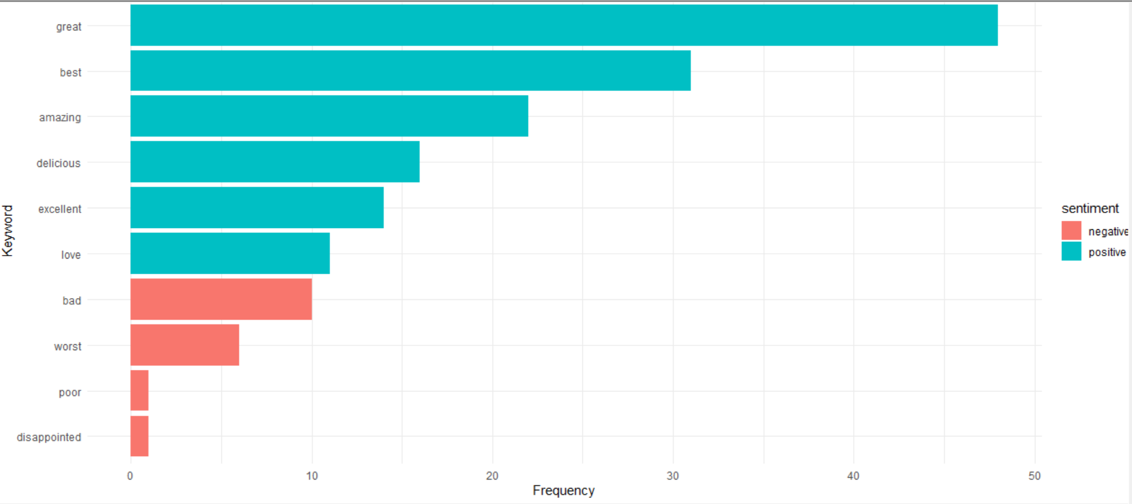

Slide 12
Ten Most Popular Words in Review
# Tokenize words
word_data <- my_data %>%
unnest_tokens(word, Review)
# Top 10 Most Popular Words
top_words <- word_data %>%
anti_join(stop_words) %>%
count(word, sort = TRUE) %>%
slice_max(n = 10, order_by = n)
# Plotting top 10 most popular words
ggplot(top_words, aes(x = reorder(word, n), y = n)) +
geom_col(fill = "skyblue") +
labs(title = "Top 10 Most Popular Words in Reviews",
x = "Word", y = "Frequency") +
theme_minimal() +
theme(axis.text.x = element_text(angle = 45, hjust = 1))

Slide 13
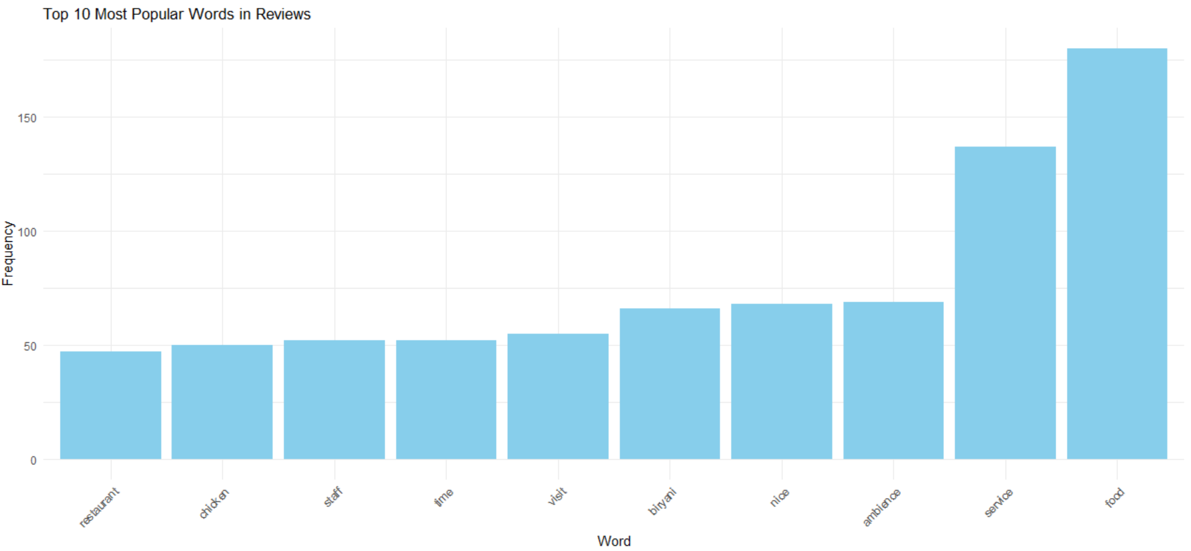

Slide 14
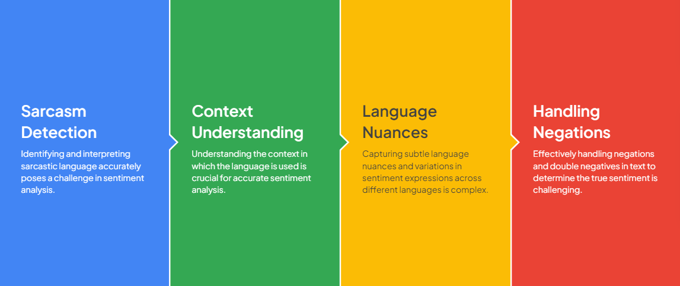
Challenges in Sentiment Analysis

Slide 15
Thank You

